Slide 1
KEYS RANDOMISER

Slide 2
ROLES SETUP
Dancan Matoke – Technical / Developer
Henry Kimani - Developer
Paul Mumo – research team
Esther Leila - research team

Slide 3
PROJECT DESCRIPTION
Data loss and other online cybersecurity crimes have become a normal happening in todays world.
Following the rampant cases of data loss and loosing of user keys and credentials online, we thought of a system that allows users to be able to keep their credentials safe by regularly updating them.
We decided to tackle first the user keys safety
This solution aims to prevent loss of credentials which will foster safety of data online.

Slide 4
Problems we aim to solve
Predictable Passwords:
Weak Keys
Password Reuse:
Phishing and Social Engineering:
Compromised Credentials:
Lack of Two-Factor Authentication (2FA):

Slide 5
Goals
Keys Randomization Algorithm:
A sophisticated randomization algorithm is employed to introduce variability to the user's key.
Dynamic Key Updates:
The system periodically updates the user's key dynamically, adding an additional layer of unpredictability.
Updates can be triggered based on time intervals, user activities, or security policies.
Session-Specific Keys:
For each login session, a session-specific key is generated.
Decryption at Authentication:
During authentication, the system decrypts the stored user key using the current session-specific key.
The decrypted key is then compared with the user-provided key for validation.
Audit Trails and Logging:
The system maintains detailed logs of key generation, updates, and authentication attempts.
Audit trails assist in monitoring and identifying any suspicious activities or potential security incidents.
Secure Key Storage:
Emphasize the importance of securely storing keys, utilizing robust encryption mechanisms to protect against unauthorized access.
User Notifications:
Users receive notifications about key updates or significant security events to ensure transparency and awareness.

Slide 6
Techniques and algorithms
Python being a powerful language will aid in creating the manager by using Cryptography to encrypt the passwords and updating them regularly using its libraries like the secret which will aid in encryption and decryption of public and private keys.

Slide 7
Requirements
The system will require the user to enable it in their default web browsers and mobile applications for it to manage user keys as they access the sites and apps

Slide 8
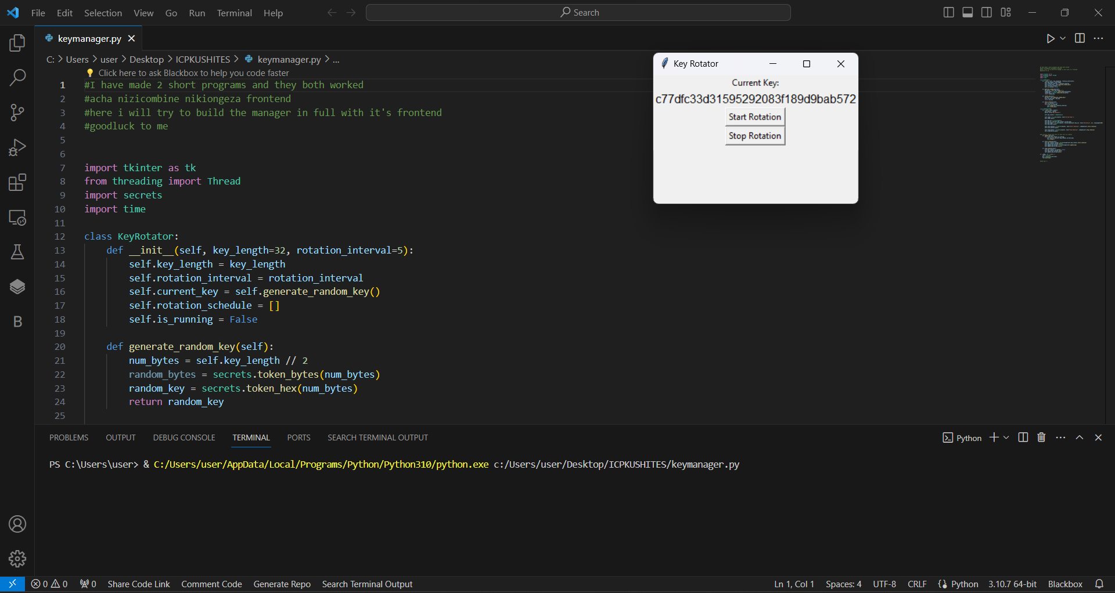

Slide 9
Flow Chart
Initial key generation
Dynamic updates
Audit trails
Key storage
User notification

Slide 10
Github
Link - https://github.com/hackmugisii/ICPKUSHITES1/blob/main/README.md
Username – hackmugisii
Repository – ICPKUSHITES1

